Slide 1
PROPAC MEETING
CITY MANAGER’S PRESENTATION

Slide 2
Presentation Layout
Follows the sequence of items listed in the invitation letter
HoDs will speak on matters that fall under their purview
CM will cover
  Status of Sec 139 Intervention
  Section 129 Oversight Report on Annual Report
  Consequence Management

Slide 3
Report on Sec 139 of the Constitution and Sec 129 of MFMA
City Manager: S. More

Slide 4
Status of Sec 139 Intervention
The city is under Cabinet Intervention as per the Constitution of the RSA sec 139 (7) (a) and (c ), and National Government took over the administration of the City
The National Cabinet Representative (NCR) took over – the Minister of Finance delegated financial management powers to the incumbent, with a multi-disciplinary team from NT, CoGTA and DoT (to oversee IPTN implementation)
Part of the responsibilities of the NCR was to assist Council with the process of appointing Sec 56 and 57 Manager, process which was accomplished
In between, the NCR developed a Financial Recovery Plan (FRP) which was approved by Council in Aug of 2023 by Council
On 1 Nov 2023, the City Manager assumed duties, on 1 Dec 2023, 5 HoDs assumed duties, and 1 June 2024, CFO and HoD PMO joined
From the date of appointing the City Manager, the NCR started wrapping up, ahead of the date of assumption of duties by all HoDs
On 1 Dec 2023, the NCR and the multi-disciplinary team was recalled, leaving the City Manager, HoDs and Acting CFO taking over their roles and powers which were delegated to NCR
The implementation of FRP started immediately after the appointments, with first War Room meeting co-chaired by NT and CoGTA – all virtual, with check-in physical meetings once in a financial year

Slide 5
UIFW – Report Summary

Slide 6
MFMA Section 129 Oversight Report
The Executive Mayor submitted a Consolidated Annual Report on the 31 of January 2026 (Annual Report for 2024/25)
The MPAC conducted public meetings on the Annual Report (dates)
The oversight report of MPAC is scheduled for submission to the next council meeting

Slide 8
MFMA SECTION 71 Reports
CFO: ZL Thekisho

Slide 9
Budget assessment outcomes from NT and level of funding against the net cash in the Cash flow – Summary of Funding
Budget Year | Status of Funding | Projected Cash Balance
2021/2022 | FUNDED | R 530 million
2022/2023 | FUNDED | R 533 million
2023/2024 | FUNDED | R 471 million
2024/2025 | FUNDED | R 475 million
2025/2026 | FUNDED | R 629 million
2026/2027 | FUNDED | R2,153 BN

Slide 10
Ratio of expenditure by type against TOTAL OPEX

Slide 11
Year on year OPEX Growth

Slide 12
Ratio of expenditure by type against TOTAL OPEX

Slide 13
Section 71 Reporting and performance
Reports are prepared monthly, submitted as Management Reports to Executive Management Team, and Section 80 Committee in accordance with the Terms of Reference of the Committee
Quarterly reports are submitted to Council – last report was dealt with by Council in the April Ordinary Council Meeting
Monthly performance is presented in the table below
 | May 2026 Year-to-date Actual | May 2026 Year-to-date Budget | Variance
 | R’000 | R’000 | R’000
Revenue by source | 9 929 225 | 10 662 810 | (733 585)
Expenditure by type | 10 079 795 | 10 492 980 | (413 185)
Surplus/(Deficit) | (150 570) | 169 830 | (320 400)

Slide 14
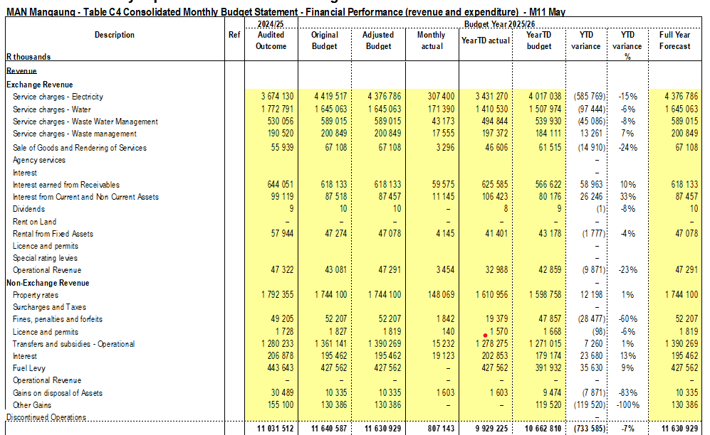
Detailed Revenue Budget Performance
Narratives
  Sale of electricity below target by 15%
  Sale of water and sanitation below targets by 6% and 4% respectively
  Waste management exceeded target by 7%
  Rates exceeded target by 1%
  Fines, penalties and forfeits below target by 60% (traffic law infringement, by-law enforcement and other fines)
  Overall revenue performance – below target by 7%

Slide 15
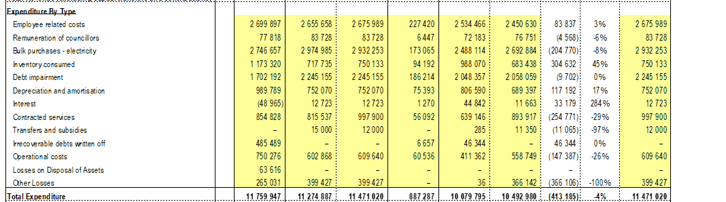
Detailed Operational Expenditure Performance
Narratives
  Employee costs exceeded the budget (overtime, acting, shift allowances main contributors)
  Bulk purchases of electricity below the target – netting of the under-billing, bringing overall deficit to R281m (R585 – R204)
  Inventory consumed exceeded budget by 40%, increasing the operational deficit of water to R500m (revenue deficit of R97m and overspending of bulk of R304m)
  Contracted services spent below target by 29%, the actual expenditure will align to norms and standards of 5%, approved budget, contracted services are 8% of the OPEX, however, this cannot be linked to capacitation of the municipality, but demand maybe reducing or utilization of contractors) – which is a good move
  Operational costs are below target by 25% - good move
  Overall OPEX is below target by 4%
  Month 11 2026, compared to Month 11 2025, the city overspent the OPEX by 5% and revenue was below target by 3%
  Unauthorized (cash) expenditure will be reported on employee costs and inventory consumed, and non-cash depreciation

Slide 16
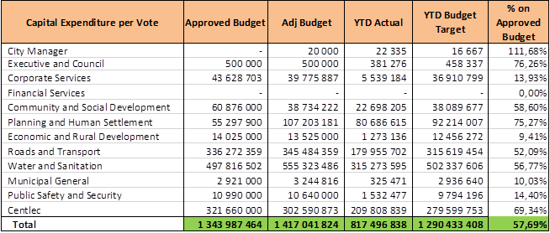
Capital Expenditure by funding source

Slide 17
INFRASTRUCTURE PROJECTS – CAPITAL BREAKDOWN
2023-24
BUDGET
R 1,296billion
- Own Funds:
R 203,1million
- External Loans:
R 0
Grants:
R 811,5 million
Public Contributions
R 14,3 million
2024-25
BUDGET
Own Funds:
R 355.0 million
- External Loans:
R 0
Grants:
R 902,7 million
Public Contributions
R14 million
2025-26
BUDGET
R 1.342 billion
Own Funds:
R 257.6 million
- External Loans:
R 0
Grants:
R 1.069 billion
Public Contributions
R15.3 million
R 1.310 billion

Slide 18
INFRASTRUCTURE PROJECTS – PERFOMANCE PER FINANCIAL YEAR
MSCOA FINANCING - MANGAUNG AND CENTLEC |  | Budget | Final Expenditure | Budget | Final Expenditure | Budget | Expenditure as at 31 March 26
 |  | 2023/2024
 |  |  |  | 2024/2025 |  | 2025/2026
 | External Loans | - |  | - |  | -
 | Own Funds (CRR) | 203 121 934 | 91 979 723 | 355 018 944 | 200 607 295 | 257 768 471 | 148 558 597
 | Public Contributions/Donations | 14 300 000 | 11 685 159 | 14 000 000 | 8 641 735 | 15 302 980 | 7 587 923
 | Grants and Subsidies
 | Public Transport Infrastructure & Systems Grant | 158 200 000 | 0 | 202 159 742 | 9 058 367 | 98 781 818 | 4 729 127
 | USDG Grant | 477 782 000 | 472 231 100 | 465 611 000 | 465 611 000 | 651 766 000 | 329 211 450
 | Informal Settlement Upgrading Partnership | 175 532 000 | 134 231 982 | 232 944 000 | 193 587 909 | 319 186 000 | 176 757 258
 | Neighbourhood Development Partnership Grant | 0 | 16 908 000 | 2 042 000 | 2 226 580 | 0 | 0
 | TOTAL FINANCING | 1 296 783 905 | 710 127 965 | 1 310 482 449 | 879 732 886 | 1 342 805 270 | 666 844 355

Slide 19
Liquidity position
Year | AFS 2025 MMM | AFS 2025 CENTLEC | CONSOLS 2025 | AFS MMM 2024 | AFS CENTLEC 2024 | CONSOLS 2024
Cash balances | 1 064 527 330.00 | 38 997 608.00 | 1 103 524 938.00 | 483 750 375.00 | 11 110 549.00 | 494 860 924.00
Trade payables | 492 031 279.00 | 1 676 577 852.00 | 2 168 511 001.00 | 403 214 583.00 | 979 152 663.00 | 1 382 367 245.00
Percentage of cash to creditors | 0.43 | 0.02 | 0.23 | 0.18 | 0.01 | 0.11
Cash coverage ratio (May of each year) | 0.19 | 0.01 | 0.11 | 0.08 | 0.00 | 0.04
Current ratio | 1.81 | 0.43 | 0.91 | 1.33 | 0.57 | 0.86
CAPEX Funding ratio
CAPEX expenditure

Slide 20
Ratio Analysis 2025
Metro | Mangaung Metro |  | Buffalo City |  | Nelson Mandela Bay
 | MMM | CONS MMM | BC MM | CONS BC MM | NMB MM | CONS NMB MM
Cash to salaries | 50% | 41% | 25% | 26% | 17% | 17%
Cash balances | 1 064 527 330 | 1 103 524 938 | 697 781 225 | 731 028 583 | 703 907 784 | 744 211 670
Salaries | 2 137 960 537 | 2 699 368 527 | 2 838 963 593 | 2 866 107 908 | 4 202 004 896 | 4 255 828 412
Cash to suppliers | 43% | 20% | 15% | 16% | 8% | 8%
Cash balances | 1 064 527 330 | 1 103 524 938 | 697 781 225 | 731 028 583 | 703 907 784 | 744 211 670
Cash to suppliers | 2 504 091 861 | 5 448 665 788 | 4 641 952 531 | 4 616 551 064 | 9 051 780 439 | 8 987 913 429
The AFS for the Buffalo city and the Nelson Mandela bay were obtained from https://lg.treasury.gov.za/ibi_apps/portal/Municipal_Documentation

Slide 21
Collection Rate – annual
Calculate based on year on year growth in debtors (Gross)
June 2020 – 77%
June 2021 – 80%
June 2022 – 78%
June 2023 – 72%
June 2024 – 71%
June 2025 – 70%

Slide 22
Indigents
 | 2020 | 2021 | 2022 | 2023 | 2024 | 2025
Number of Indigents | 32007 | 51700 | 51464 | 60680 | 65391 | 66948
Indigent debt written off | 206 380 916 | 6 855 912 | 122 452 573 | 286 549 814 | 692 488 067 | 382 350 976
Cost of free basic services | 423 502 352 | 496 149 041 | 516 062 689 | 589 614 211 | 649 508 784 | 697 034 808

Slide 23
Receivables
 | 2020 | 2021 | 2022 | 2023 | 2024 | 2025
Gross debtors 30 June | 6 683 005 657 | 7 731 546 206 | 8 885 369 662 | 10 005 105 611 | 11 160 860 322 | 12 990 353 187
Residential | 3 603 765 149 | 4 434 224 355 | 5 270 928 329 | 6 291 819 061 | 7 065 625 237 | 8 262 375 134
Business | 931 450 499 | 1 170 733 041 | 1 328 770 860 | 1 608 492 933 | 1 913 985 559 | 2 266 023 721
Government | 1 761 502 168 | 1 720 917 747 | 1 861 342 679 | 1 937 383 600 | 1 938 580 798 | 2 233 971 029
Other | 386 287 841 | 405 671 063 | 424 327 794 | 167 410 017 | 242 668 728 | 227 983 303

Slide 24
FRP PROGRESS
CFO: ZL Thekisho

Slide 25
Progress in implementing FRP
FRP was adopted by Council in August of 2023
The first quarterly war room started in March 2024
Currently implementing the rescue and stabilization phases
Main outcomes under rescue phase
  Governance and institutional – functional committees, political stabilization, and council functionality, Section 56 and 57 employees
  Service delivery – masterplans, loss reductions, water conservation, blue drop, metering, refuse collection, IWMP, landfill licensing
  Financial management – funded budget, revenue management, cost containment, indigent households' management, SCM compliance CAPEX grant compliant spending
Approaching end of third year – still in rescue phase
The plan is currently being reviewed as we are moving to stabilization and sustainability
Achievements
  Liquidity stabilisation – 3months cost coverage
  Funded budget
  Reducing UIFW, from an average of R1,3bn to R1,bn, 3rd quarter 2025/26 YTA below YTB by R230m
  Challenge is revenue not meeting targets – CENTLEC and Water and Sanitation
  Development of all Masterplans – all in progress, not yet approved by Council
  Restoration of service delivery – refuse removal, certainty of water, limited water outages and rationing
  Functional committees (Section 79, 80, MAYCO, Budget Steering Committee and Council)

Slide 26
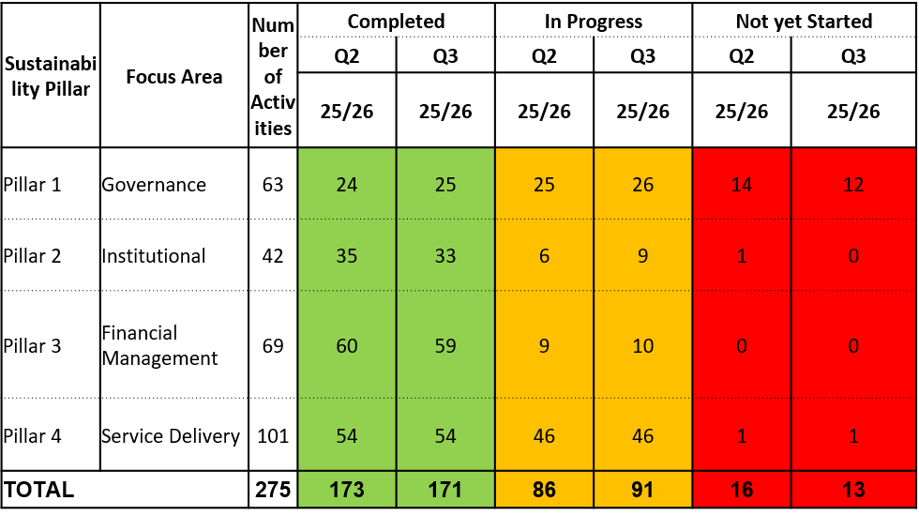
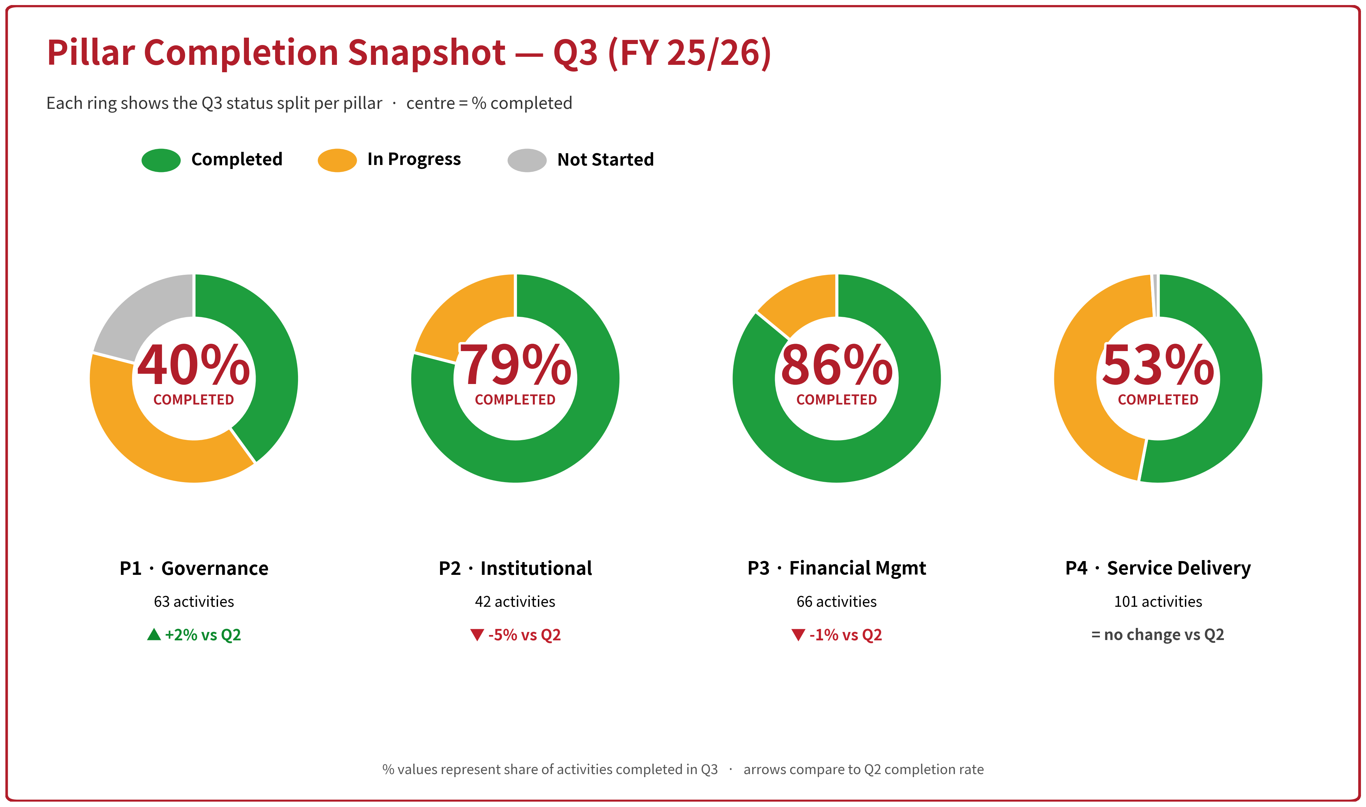
FRP Implementation – NT CoGTA Assessment

Slide 27
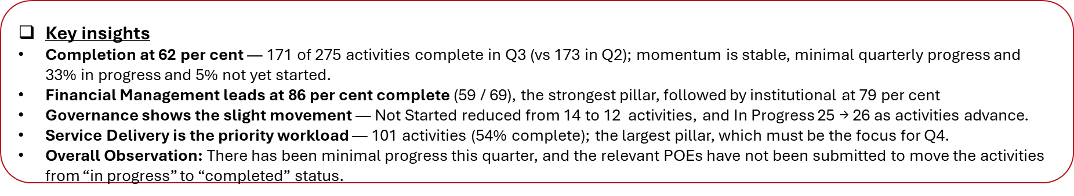
NT Highlights on FRP
These were made by NT in their presentation

Slide 28
Progress: Quarters 3 of the 2025/26 Financial Year
Pillar | Qtr 3 Progress | Target for Qtr 4
FINANCIAL MANAGEMENT | reconciliation report. There city is developing proposed tariffs and are in the process of developing draft tariffs to inform the 2026/27 budget. Reconciliation of property rates revenue and identification of arrears for which billing must be improved. Session with the Department of Education on debt owed. Disconnection and connection Signed a 5-year plan for the new Eskom debt repayment. | Identify consumers not billed for water consumption and expedite billing of those consumers. Progress on the collaboration framework on collection, which was due in July 2025 and no tangible progress to date. Implementation of credit control and debt collection mechanisms to increase revenue collection. Commence with the preparation of audit working papers and engage the AG early to address prior-year corrections. Develop a plan to address the City’s accumulating Eskom debt. Improve the disclosure and narrative of the creditors in the section 71 report. The draft 2026/27 trading services tariffs should, where possible, reflect the tariff assessment outcomes, including staggered implementation, in the draft budget to be tabled by the end of March. Develop and approve a funded budget for 2027-2023 MTEF

Slide 29
Progress: Quarters 3 of the 2025/26 Financial Year
Pillar | Qtr 3 Progress | Target for Qtr 4
SERVICE DELIVERY | the baseline of 1.6% even though still lower than the norm. Maselspoort WTW filters are under refurbishment to improve water quality implementation progress at 91 per cent. Development of the water master plan is at 95% Progress, Report Revision 4. The envisioned completion is end of April 2026. The municipality conducted meter audits of over 40 000 water meters. Twenty thousand were dysfunctional and required replacement (estimate replacement cost of R194m). The municipality has reported completion of the refurbishment of pumps, motors and clarifier bridges in Botshabelo Wastewater Treatment Works. The municipality also reported completion of clarifier bridges and motors at the Thaba Nchu Wastewater Treatment Works. Electricity Losses within the norm. . | Technical Systems - System landscape analysis report. The municipality is requested to report Blue Drop activity progress on each of the treatment works; Bloemfontein, Dewetsdorp, Thaba Nchu, Vanstadensrus , Wepener, Botshabelo and Soutpan. The municipality is requested to report on the remedial work on each of the treatment works, namely; the Northern Works, Bloem Industria, Soutpan, Dewetsdorp, Van Stadensrus Wepener, Bloemspruit, Botshabelo and Sterkwater.

Slide 30
Progress: Quarters 3 of the 2025/26 Financial Year
GOVERNANCE | Qtr 3 Progress | Target for Qtr 4
 | Collection through direct deduction from salaries of arrear amounts for councillors and staff. UIF&W quarterly reports to the EM and annual to Council tabled. Sitting of contract management committee Monthly update of the litigation register. Reporting on revenue generated from enforcement of by-laws | The following priorities with direct financial implications for quarter 1 2025/26 are repetitive since quarter 1 2024/25 financial year, with no material progress. Give effect to the section 142 statutory compliance requirements by implementing the approved financial model. Conduct cost implication analysis on underfunded and unfunded mandate agreements. Reconciliation of Council resolutions on land alienation and Deeds office records for the period of five years ending June 2023. Quarterly report to Council on councillors and staff in arrears and monthly financial report on arrears collected and honouring of current accounts. Section 32 investigations on UIF&W expenditure. Monthly progress reports on the implementation of the post audit action plan to the audit committee and Council. Review existing contracts against the organisational structure and staff to determine duplication of services. Address the material irregularities as per Auditor-General’s recommendations.

Slide 31
Progress: Quarters 3 of the 2025/26 Financial Year
GOVERNANCE | Qtr 3 Progress | Target for Qtr 4
 |  | Review lease agreements on all Council owned immovable properties. Progress reporting to Council on implementation of FRP. Progress on implementation of UIF&W reduction plan. Development of strategic partnerships for alternative revenue streams. Review evergreen contracts consistent with the letter received from the National Treasury. Finalise the review of existing contracts against the organisational structure and staff to determine duplication of services and costs.

Slide 32
Progress: Quarters 3 of the 2025/26 Financial Year
INSTITUTIONAL | Qtr 3 Progress | Target for Qtr 4
 | The Micro-Structure has been approved. Busy with a collective agreement on the draft Migration and Placement policy with Organised labour to regulate the placement process. Voluntary implementation of the shift system is steadily advancing, even though the pace is gradual and marred with Organised Labour disputes. It has been noted that the municipality is actively working to improve communication and change management, leading to a more effective employee engagement experience. | Resolve the dispute with labour on the Placement of employees on the new microstructure. Conduct an efficiency audit on the utilisation of staff to minimise redundancy. Resolve the impasse on the implementation of the shift system across all service delivery units to mitigate against overtime costs. Cascading of the Performance management system to lower levels to be prioritised. The Municipality must re-align the macro structure to include the provisions for trading services business case. The Municipality must plan for the shared services platform to provide strategic support to the Municipality and its trading services. Management of employee costs so that it does escalate beyond affordability rate due to high vacancy rate.

Slide 33
AUDIT OUTCOMES, REPEAT AUDIT FINDINGS AND AAP
CFO: ZL Thekisho

Slide 34
Overview
Over the past five years, the city received the following audit outcomes
  2024/25 – Qualified – current management
  2023/24 – Qualified – with intervention
  2022/23 – Qualified – with Intervention
  2021/22 – Unqualified – no intervention
  2020/21 – Unqualified –no intervention

Slide 35
Audit Outcomes (Consolidated)
2022
Unqualified
2021
Unqualified
2023
Qualification
2024
Qualification
2025
Qualification

Slide 36
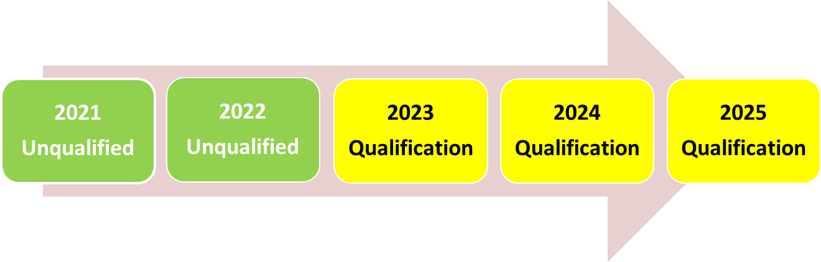
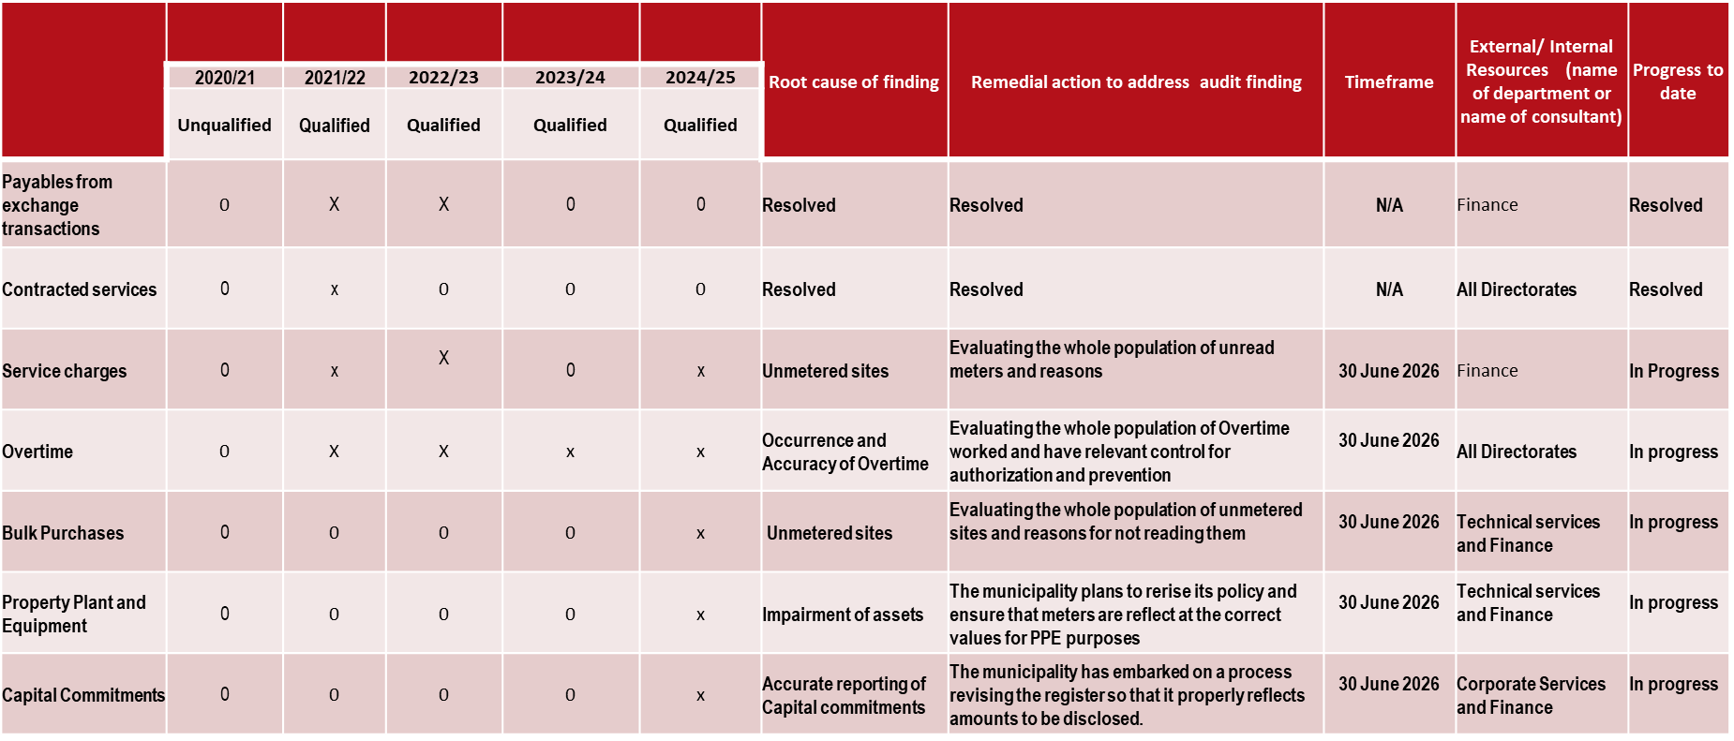
AUDIT OUTCOMES

Slide 37
Repeat audit findings year on year
Repeat - Overtime qualification
New qualifications
  Service charges
  Impairment of sanitation assets and water meters
  Commitments
  Water losses

Slide 38
Progress on Audit Action Plan

Slide 39
REPORT ON MATERIAL IRREGULARIES
CFO: ZL Thekisho

Slide 40
Introduction
Though MIs are issued to the City Manager, these are caused in the departments
HoDs have responded to MIs issued on matters under their scope, management and control, and as to such responded to AGSA
All responses had been reviewed by AGSA – common finding is that HoDs are not addressing the issues raised but are explaining, and not provide/or take appropriate action necessary to hold subordinates accountable whilst putting up corrective and preventative measures
In cases where AGSA has made recommendations, HoDs do not implement the recommendations made, hence the escalation of MIs rather than the resolution or clearing

Slide 42
Status of MI and progress
Developed SoP on Handling of MI – provide clarity and guidance
Total MIs 27
Investigations conducted (6 in-house conducted, IPTN Trunk Route, SALA, Fuel losses, Vista Park Extension 3, Community Hall Thaba Nchu and Fire Station Botshabelo)
ICT investigation (referred to external investigation)
Ongoing engagements with AGSA
Summary of MI statuses
  10 new MI – still on investigation and implementing AGSA recommendations
  5 are on remedial actions
  11 are on referral
  1 verbal submissions preceding the issuance of the debt certificate
Out of 11 on remedial – 8 deals with Sanitation and Water, 3 on landfill sites
Water and Sanitation
  Refer to water quality presentation to follow
  Capital investment
  Landfill sites – DESTEA intervention on the cards, skills development

Slide 43
Handling of MIs in future
Established a dedicated committee to register and review submissions on MI and provide guidance and support
It is our view that MIs should be resolved at the level of “preventative measures” and not go further to recommendations and referrals
This will be achieved by adopting this strategy
  MI notified must be regarded as a financial misconduct and must be reported to Council for referral to MPAC for investigation (recovery or write off)
  In a case where the misconduct is tantamount to offence, it must be referred to the FDB to investigate
The following will be expected from the HoD affected
  Conduct investigation of the root cause of the MI
  Develop preventative measures
  Capacity building in the directorate
  In cases where procedures, job- descriptions and learning is necessary – conduct such
  Institute departmental disciplinary processes
Respond to AGSA and submit all supporting documents (investigation report, preventative measures, internal processes followed) for assessment
Act on recommendations of AGSA and provide evidence
MI must close

Slide 44
SCM ROLE AND STATUS OF PROCUREMENT PLAN
CFO/GM: SCM

Slide 45
Procurement Plan Execution
HoDs submit procurement plans, which SCM consolidates as an institutional plan, signed off by the CM by no later than 31 July of each year
HoDs are responsible for ensuring that the appointed Project Managers submit specifications within their own timeline to SCM, for SCM to convene the Bid Specs Committee – for 2025/26, no specs was submitted within the timelines determined by the HoD
When the Specs is eventually received, Project Managers demonstrate challenges in giving clarities to the Committee, which further delays finalization of the Specs for advertisement, this may take up to 3-months to finalise specs submitted
Once the specs is finally approved, immediately after opening of the bid, bid documents are submitted to the user departments, to compile a technical report – the city has procedures for Technical Evaluation of Bids by User Departments (special conditions they set in the evaluation criteria)
Bid Evaluation Committee sits once SCM has received the Technical Evaluation Report from the directorate
The table below shows an average number of days it takes for directorates to return the report

Slide 46
Summary of days taken to submit Technical Report

Slide 47
Expenditure – payment culture

Slide 48
SCM Non-compliances
2024-25
EV - (MR) CoAF 34 - Procurement and contract management: Monthly monitoring reports not submitted on BID689: 2023/2024 (Contract C756) - (ISS.34)
Procurement and contract - INSTALLATION OF WATER AND SEWER IN TAMBO SQUARE (MMM/BID 766: 2024/2025) Contract no: C828 - (ISS.237)
Procurement and contract management - APPOINTMENT OF 2 CONTRACTORS FOR REPLACEMENT OF WATER METERS AND METERING OF UNMETERED SITES IN ALL AREAS OF MANAGAUNG METROPOLITAN MUNICIPALITY AS AND WHEN REQUIRED (MMM/BID 691(A) - (ISS.222)
Procurement and contract management - APPOINTMENT OF A PANEL OF SERVICE PROVIDER(S) FOR THE SUPPLY AND DELIVERY OF WATER TREATMENT CHEMICALS, DOSING, TESTING EQUIPMENT LABWARE (MMM/BID 708: 2023/2024) Contract no: C778 - (ISS.221)
Procurement and contract management - Deviation: Mime Cast Cyber Security - (ISS.246)
Procurement and contract management - Deviation: Overseeding and maintenance of the grass pitch area at Dr. Rantai Molemela Stadium - (ISS.255)
Procurement and contract management - Deviation: Procurement of ticket sales / personnel for the Hauweng Bus operations - (ISS.249)
Procurement and contract management - Deviation: Request for approval to renew FortiGate firewall licence (20 months) - (ISS.256)
Procurement and contract management - EMERGENCY UNBLOCKING, MAINTENANCE AND REPLACEMENT OF MANHOLES AND SEWER PIPES AROUND MANGAUNG METROPOLITAN MUNICIPALITY, AS AND WHEN REQUIRED (MMM/BID 722: 2023/2025) Contract no: C787 - (ISS.244)
Procurement and contract management - High vacancy rate within SCM unit for 2024/25 - (ISS.100)
Procurement and contract management - INSTALLATION OF WATER AND SANITATION AT MKHONTO ERF 32109 SALIVA 35180 AND 8323 (MMM/BID 747: 2024/2025) Contract no: C808 - (ISS.240)
Procurement and contract management - Interest business partners - (ISS.220)
Procurement and contract management - Matters noted on contract management - (ISS.275)
Procurement and contract management - Supplier not registered for VAT - (ISS.213)
Procurement and contract management - SUPPLY AND DELIVERY OF CONSUMABLES FOR MANGAUNG METROPOLITAN MUNICIPALITY (MMM/BID 735: 2023/2025) Contract no: C792 A/B - (ISS.236)
Procurement and contract management - THABA NCHU WATER AND SANITATION AT EXT27 MAROKA AND RATAU (MMM/BID 676(A): 2024/2025) Contract no: C811 - (ISS.228)
Procurement and contract management - THE INSTALLATION OF WATER AND SEWER IN BOTSHABELO SECTION H2873 AND G1011 (MMM/BID 749: 2024/2025) Contract no: C821 - (ISS.225)
Procurement and contract management: BiD_ 687(AA)_Debt collectors panel - (ISS.310)
Procurement and contract management: BID_727_Fleet panel - (ISS.312)
Procurement and contract management: BID_694_BBT construction - (ISS.311)
Procurement and contract management: Limitation RFI 255_All information not submitted - (ISS.152)
SCM unit is performing its role (framework contracts, bid adverting, bids closure, supporting bid committees)
Key issues lies with advertising (Bid Bulletin, is being scrapped, bids to be advertised immediately after approval by BSC) cut time between bid specs and bid advertising
Technical evaluation by user directorate – contributes to slow finalization of bids – not in the control of SCM but respective HoD, look at possibilities of performing this concurrently with BEC
Bid committees functional – BAC sits every Friday, BEC Wednesday and Thursday and BSC Mondays
All CoAFs were cleared – non remained or reported in the Management Letter except for
  Procurement and contract management: BID_694_BBT construction - (ISS.311)
  Procurement and contract management - Interest business partners - (ISS.220)
  Both matters were referred to Fraud and Risk Management unit – awaiting report
SCM challenges – none, despite being 60% under-staffed, however, automation is being planned for the entire function, receiving of bids, compilation of bids opening register, admin checks on bids received (takes longer in cases where too many bids must be processed, recommended timeline 5 days to receive, process and handover bids to user-department for technical evaluation
User departments must return the bids with technical reports within 14 working days, however, the worst case is 10 months - Appointment of 4 (four) panel of service providers re-vitalisation and vacuuming of ventilated pit latrine and 185 days – Bid Construction of basic water and Sanitation networks in the Mangaung – ISUPG Funded under Human Settlements, best less than 14 days (only framework tenders, Corporate Services, and Workshop)

Slide 49
Interventions to fast-track procurement
Introduction of PMO to execute bidding processes and payments whilst directorates and Project Managers focus on project execution, management of contract and delivery of the project
With the number of days it takes to return the technical report, the conditional grants expenditure will be affected as those tenders are of the current year, not the next year of the MTREF – if 3 months is spent with tender documents being at user directorate, clearly, site handover can only take place late in the financial year
Delays in submitting technical reports affects all tenders, be it panel appointments or normal tender

Slide 50
REVENUE ENHANCEMENT AND DEBT COLLECTION
CFO ZL THEKISHO

Slide 51
Customer/Revenue base profiling
The metro is very rural – generating R129 billion GDP, with no light or heavy industries, unlike other cities, and nearly 2% to National GDP
The metro has 37 villages under the Barolong Tribal Authority
Population is concentrated in the age groups between 20 and 44 – where unemployment is highest
Community and Government are the largest drivers of the economy
60% of households depend on grants
Out of 276 905 households, 167 000 of these are indigent
With ISUPG, the city continues to upgrade informal settlements with slow growth on middle to income houses being built, no emergence of industrial development or massive and visible investment
The city has an entity which successfully distributes through prepaid electricity meters (195 000), whilst the parent is distributing water on 18 000 prepaid, 248 000 conventional water meters
Townships collection rate is anything between 0% to 5%, despite the fact that there is a service cente in every town
The city launched Operation Patala – customers are raising timing issues of launching the operation
The city is busy registering Indigents – project experienced set-backs, target is 120 000 by end of June, with the set-back, the number is doubtful (community outreach to assist households to use the gadgets – registration is through a system, no longer completion of forms

Slide 52
Revenue enhancement and debt management
Focus is growth without dependency on tariffs – Approval of township developments (private sector and government (Vistas nor progressing)
Complete and equitable GVR – achieved
Properties not complying with MPRA – multiple use – split in the new GVR (outcry and objections received) all being dealt with – small holdings registered as all farm, paying 0.25 of residential rates, now, residential portion will be aligned and levied accordingly
Closed the Valuation 2022 – 2026, appeal board certificate received
Metering of unmetered areas
Implementation of water smart meters (part of Water and Sanitation Trading Services Reforms)
Pricing optimization – financial modelling for trading services (water, 0-6kl sold at loss, now adjusted, resulted in overall increase of 14,4% for 2026/27)
Perform valuation roll recon and billing quarterly – completeness of billing
Master Data Management – requirement with reforms coming into effect (opening and closing of accounts, installation, decommissioning and replacement of meters BP Engineering critical
Certificate of service as a minimum and absolute requirement for billing – to avoid Grassland matter (petition)
Continue with the implementation of Collection Action Plan (resolve all issues with CENTLEC)
Updated Indigent Register – system-based processes adopted and in implementation (staff issues – casual workers needed to support walk-ins at the service points and assist ward-based outreach)
Monthly meetings with service delivery departments (metering, reading, billing, customer management, disputes, RCC issues)
Continue with Collection Action Plan (disconnect non-payers)
Panel of debt collectors to augment own capacity (commission based)
Data cleansing and revenue leakage exercise – tender out
Meter management
Use of prepaid vending system to collect rates and taxes (policy makes provision, but not yet implemented – waiting for CENTLEC collaboration)
Monetizing municipal assets (advertising boards, investment property, idle assets and auctioning)
Online and self-service payment portals
Aggressive credit control

Slide 53
Revenue and collection rate Residential areas – Low income

Slide 54
Cash from operations in last 7 financial years

Slide 55
Ratio analysis on cash flow in the last 7 financial years

Slide 56
Vaal Central Water / ESKOM Bulk accounts
Vaal Central Water:
  The city entered into payment arrangement with VCW on 19 February 2024 with the following terms:
    The total arrear debt with VCW was R 606 310 208 at the date of the arrangement
    Payment of monthly current account every month
    Payment of arrears in line with receipt of tranches of equitable share receipts starting on July 2024 and paid every July, December and March month to an amount of R 35 million and a final payment of R 46,31 million in December 2029
  The city has kept to this payment arrangement and status since entering this arrangement:
    Outstanding balance as of end of Quarter 3 (March 2026) is R 396 310 208
    Current accounts are settled every month and total payments made since arrangement = R 2,301 billion was paid
    Through negotiations and engagements with VCW, the board wrote off R 287 million (R 192 million related to 2024 and prior years) of interest due to maintaining of the payment arrangement and the understanding that future interest write offs will be considered if payment arrangement is maintained
  Cash coverage ratio of the city at end of third quarter was 4.42 months and the city has provided for 3 months of VCW accounts in call accounts

Slide 57
Vaal Central Water / ESKOM Bulk accounts
ESKOM Bulk account:
  Centlec applied and was approved to be part of the MFMA Circular 124 Debt relief program from NT and ESKOM on 7 August 2023
  The total initial debt that formed part of the arrangement was R 386 820 878.43
  NT has approved the write off of the first two tranches of the debt relief program which totals to R 257 880 585.62 for meeting the majority of the conditions as per the circular with the third and final cycle currently in progress

Slide 58
Revenue and collection rate
The consolidated collection rate of the city averages between 73% and 78% historically
Electricity collection rate is above 95% while water collection is much lower at 50%
Electricity is a much more effective tool for recovering arrears from consumers as water is a basic right in terms of the constitution and has challenges of minimum flow (trickle) which has to be provided where electricity can be disconnected in full
Costs of disconnection of water is also very expensive – Last 18 months total cost of R 33 million paid for notices and disconnections on water alone
There is currently no collaboration between Centlec and the City in terms of consolidated billing and collection initiatives due to the following challenges
  Centlec was established as a company in terms of the companies act which requires their own bank account to be created while the MFMA Section 8 requires one bank account for all receipts of monies
  Both entities utilise the same financial system (SOLAR), but have separate billing systems which is not integrated as well as prepaid meters residing in a separate vending system
  As the city is currently revising it’s FRP, this item is to be included as a priority item which the city will have to resolve

Slide 59
INFRASTRUCTURE DELIVERY FAILURES
HOD MASOBENG, HOD THINDA

Slide 60
Infrastructure delivery failures
According to national Treasury (2024), it was noticeable that municipalities will be hit by a deficit on the operating budgets of 2024/2025 financial year because their total operating expenditure was increasing at a rate that is higher than their revenue projections. The situation that is persisting in 2025 / 2026.
It is very apparent that financial crisis can lead to a breach of either financial obligations or service delivery obligations. It is further understood that the emphasis in the MFMA is on financial obligations. This emphasis is logical in an Act that deals with financial management.
The burden of establishing a breach of a service delivery obligation would usually be harder to meet for the following reasons: (i) as both a legal and a technical matter, establishing exactly what the municipal service delivery obligations are in a specific context is difficult to be understood, and (ii) in addition, establishing the link between a service delivery failure and a financial crisis adds a layer of complexity.
Since, the MFMA provides little detail, it would also be necessary to navigate a complex maze consisting of the Constitution, the relevant sectoral legislation with its regulations and any norms or service delivery standards that the municipality must abide by, when determining whether a serious or persistent material breach of service delivery is taking place.
The four points made above seek to highlight that stringent operating budget caused municipalities to have deferred maintenance. This practice of postponing necessary upkeep and repairs of infrastructure has compounded costs. Compounded costs that are continuing to grow; leading to the asset failures we are noticing.

Slide 61
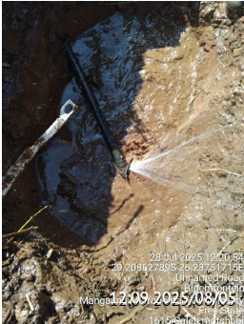
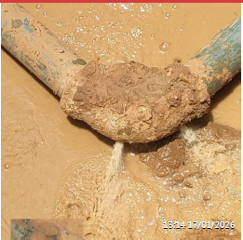
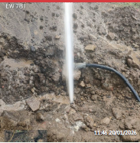
Infrastructure delivery failures (Water)

Slide 62
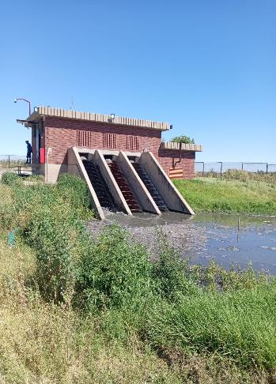
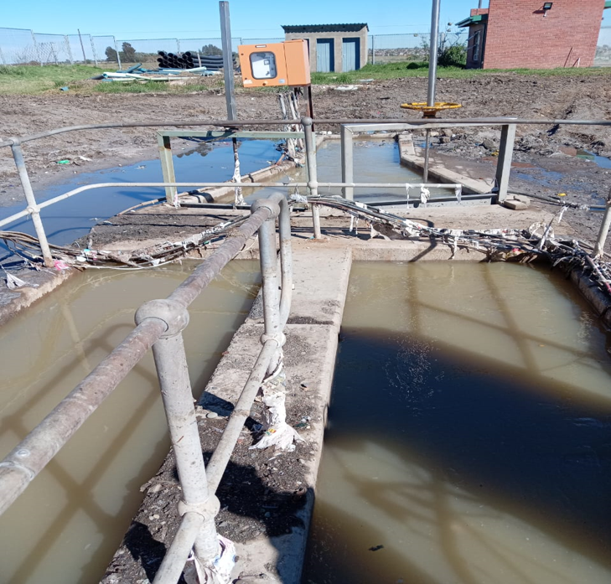
Infrastructure delivery failures (Sanitation)

Slide 63
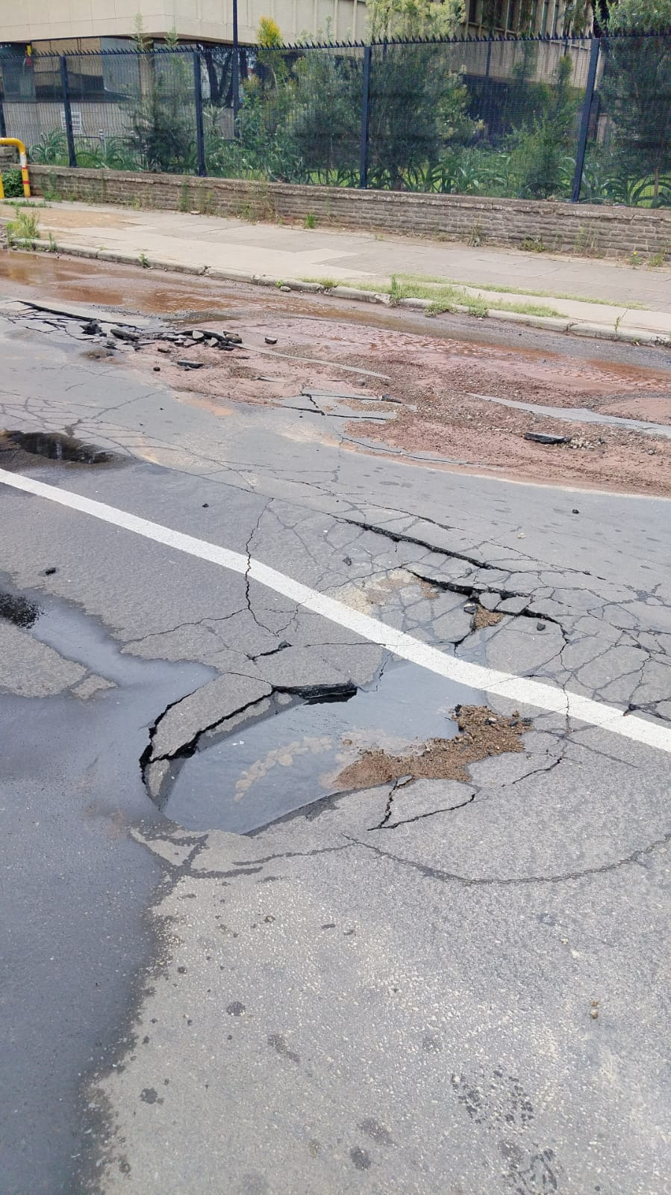
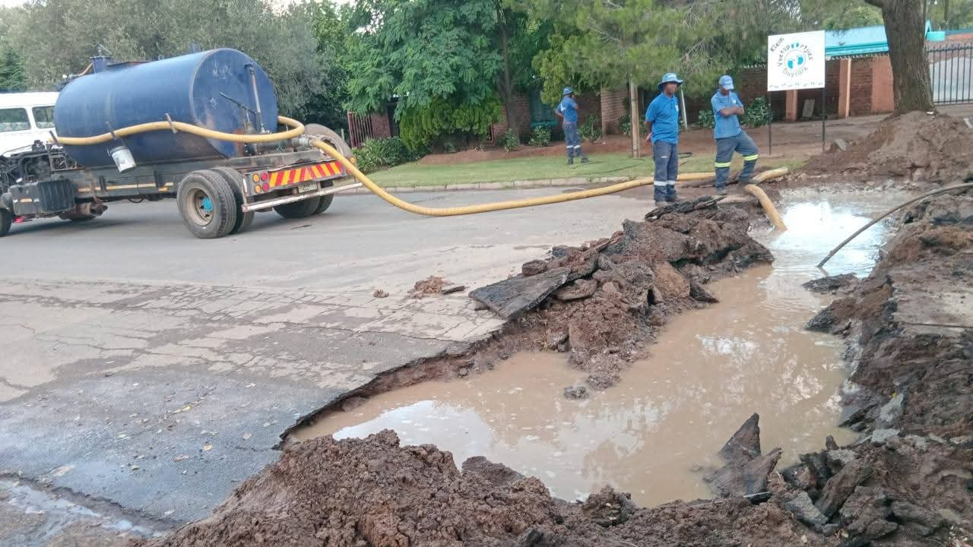
Infrastructure delivery failures (Roads)

Slide 64
UNDER PERFORMANCE OF GRANT FUNDED PROJECTS
FROM EXPEDITURE AND PAYMENTS PERSPECTIVE
CFO

Slide 65
Overview of conditional grants expenditure

Slide 66
ISUPG Projects with 0% spending

Slide 67
Projects on target – ISUPG

Slide 68
USDG – Projects with 0% spending

Slide 69
USDG Projects on target

Slide 70
Payments procedures and culture
Payments are processed by user directorates (all invoices are delivered to user directorates via the Project Manager)
The city has a system where payments are processed (user directorates uploads invoices and supporting documents) – within 15 days from the date of receipt of the invoice
Invoices loaded go through the validation process (checking all supporting documents, rates, work measurements, Consultants Report) to ensure payments are made for work done (city had no finding on payments processes and validity, except a concern raised by AGSA that we may be paying for goods and services not received)
City Manager instructed Internal Audit to conduct payment process review and identify bottlenecks – report revealed user directorates as a problem
The Executive Mayor did the same, appointed a team of MMCs to investigate, these reports are provided as part of documents supporting this presentation
Having seen the number of 0% spent projects at month 11, procurement issues already alluded to, the city must relook at PMO playing a significant role (execution of the procurement plan and processing of payments)

Slide 71
Payments’ culture

Slide 72
INSTITUTIONAL CAPACITY
HoD Duma

Slide 73
Governance and institutional capacity
Participating in the trading services reforms – like all other metropoles
Functional council – all ordinary and special council meetings took place
Approved Rules of Order of Council
Annual declaration of interests by Councillors
Approved organizational structure
Section 79 and 80 Committees set-up – not regularly submitting oversight reports to Council
Functional Risk Management Committee in place, had 4 meetings and first bi-annual report submitted to Council
MPAC not submitted reports to Council, last report was December 12, 2025 – Write of off interest accumulated on Vaal Central account
All Section 56 and 57 positions filled
Critical vacancies filled (Engineering, Finance, Solid Waste GM)
FRP implementation continuing, under review by NT
Funded budget
Implementing Audit Action Plan
Alternative supply of fleet – full maintenance lease

Slide 74
SERVICE DELIVERY CHALLENGES

Slide 75
TECHNINCAL SERVICES
HOD: Masobeng

Slide 76
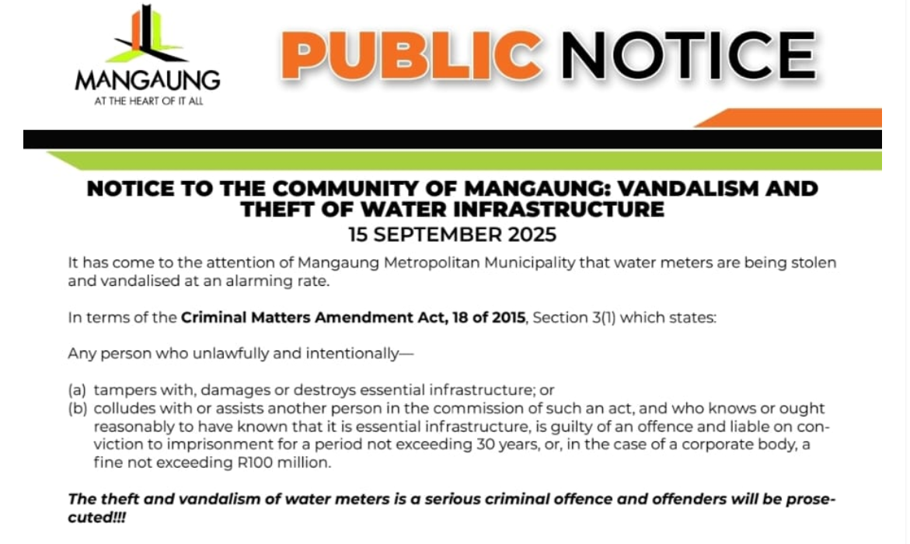
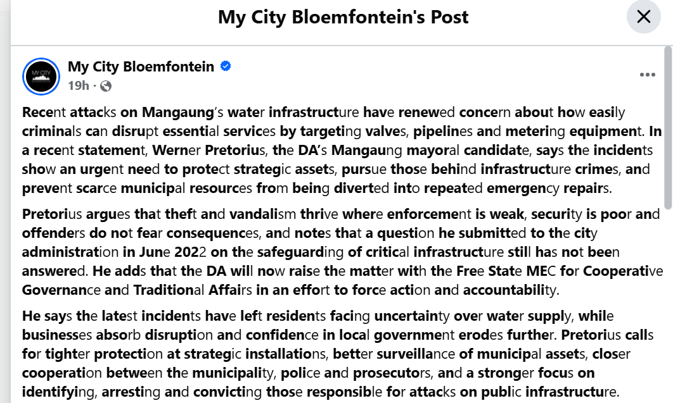
Service delivery challenges
Vandalism of critical bulk infrastructure
https://chieftechnologyofficer-my.sharepoint.com/personal/zuziwe_thekisho_mangaung_co_za/Documents/Documents/CITY%20MANAGER'S%20OFFICE/PRO%20PAC%20FS/VID-20260611-WA0011%20(1).mp4

Slide 77
Service delivery challenges (Water)
Indicator | Current Status | Key Challenges | Intervention Required
Households with access to water | 715 120 | Inadequate bulk infrastructure Population growth and urbanization. Limited funding | Infrastructure development and upgrades. Increased investments (BFI and conditional Grant) Alternative sanitation
Average duration of water interruptions | 12-24 hours | Ageing Infrastructure Inadequate funding | Increased investments (BFI and conditional Grant)
Non-Revenue Water (%) | 50.6% | Ageing Infrastructure Inadequate funding High vacancy rate (58%) | Regular maintenance Approval of BFI Education and awareness

Slide 78
Service delivery challenges (Water)
Overview of WCDM Strategy Outline
Driver | Secondary | Strategy Number | Description of Strategy | All Strategies Cost Estimate (Excl. VAT) R Million | 2024/25 Budget (Excl. VAT) R Million | 2025/26 Budget (Excl. VAT) R Million | Budget Shortfall for 18 Strategies (Excl. VAT) R Million | Status
Demand/System Input Volume (SIV) Reduction | Real Loss (RL) Reduction | Srategy RL1 | Pressure and Network Zone Management | 61,38 | 9,30 | 13,90 | 38,18 | Implemented
 |  | Srategy RL2 | Pro-Active Leak Detection & Repair | 114,56 | 3,04 | 3,10 | 108,42 | Partially implemented*
 |  | Srategy RL3 | Maselspoort Upgrade Phase 1: Maselspoort RisingMain River Crossing and Refurbishment of Pipeline | 47,61 | 1,10 | 1,60 | 44,91 | Project to be readvertised, could not get potential bidder. New advert to be out before end of June 2026. Budget made available in MTRF starting from 2026/27 financial year.
 |  | Srategy RL4 | Pipe Replacement Project | 61,83 | 7,50 | 8,40 | 45,93 | Implemented
 |  | Srategy RL5 | Routine or Domestic Leak Repair Programme | 133,77 | 24,68 | 50,90 | 58,19 | Implemented
 |  | Srategy RL6 | Valve Replacement Programme | 66,16 | 6,40 | 6,29 | 53,47 | Implemented
 |  | Srategy RL7 | Soutpan Pipeline Detailed Audit, Leak investigation and Leak Repairs | 3,27 | 0,00 | 0,00 | 3,27 | Implemented
 | Apparent Loss (AL) Reduction | Strategy AL1 | Standpipe Audit and Disconnection of Standpipes in Areas with Formal Reticulation | 0,64 | 0,00 | 0,64 | 0,00 | Implemented
 |  | Strategy AL2 | Replacement of Water Meters* | 349,53 | 12,72 | 20,87 | 315,94 | Implemented
 |  | Strategy AL3 | Billed Metered Consumption Audit, Digistisation and Automisation | 13,09 | 0,00 | 0,00 | 13,09 | Not Implemented
 | System Input Volume (SIV) Reduction | Strategy SIV1 | SCADA & Telemetry (including installation of Bulk Check Meters | 80,42 | 2,60 | 12,00 | 65,82 | Contrator has been appointed, site handover to be done in June 2026. Budget made available in MTRF starting from 2026/27 financial year.
Increasing Billed Metered Consumption (BMC) |  | Strategy SIV2 | Maselspoort Treatment Upgrades and Refurbishment | 1345,53 | 28,00 | 64,50 | 1253,03 | Implemented (Phased Approach)
 |  | Strategy SIV3 | Water Re-Use | 1800,00 | 0,50 | 3,00 | 1796,50 | Application for funding with ISA
 |  | Strategy SIV4 | Consumer Awareness and Education Programme | 17,18 | 0,00 | 0,00 | 17,18 | Not Implemented
 | Increasing Billed Metered Consumption (BMC) | Strategy BMC1 | Metering of Unmetered Sites | 412,05 | 0,00 | 0,00 | 412,05 | Not Implemented
 |  | Strategy BMC2 | Prepaid Programme (Installation of Automated Meter Readers) | 1,64 | 0,00 | 0,00 | 1,64 | Partially implemented*
 |  | Strategy BMC3 | Identify Bad Debt Consumers | 66,12 | 0,00 | 0,00 | 66,12 | Not Implemented
 |  | Strategy BMC4 | Reticulation Backlog and Metering of Sites | 1127,93 | 0,00 | 34,50 | 1093,43 | Implemented
Total Required (Excl. VAT) |  |  |  | 5702,71 | 95,84 | 219,70 | 5387,17
NOTE: *Implemented with limitations in terms of available budget

Slide 79
Service delivery challenges (Water)
Based on the 18 identified strategies, the total estimated cost to implement the Non-
Revenue Water (NRW) Reduction Programme over a 10-year period is approximately R5.70 billion.
Following a detailed assessment undertaken in Year 1 (FY 2024/2025), it was determined that the Municipality required a
minimum budget allocation of R512.10 million to achieve the planned annual targets. However, due to financial constraints,
only R95.84 million was budgeted, resulting in a funding shortfall of R416.26 million for that financial year.
For Year 2 (FY 2025/2026), the required budget was estimated at R808.80 million, while only R219.70 million was allocated.
This resulted in a further funding deficit of R589.10 million.
Collectively, over the first two financial years, the Municipality has experienced a cumulative budget deficit of approximately \
R1.005 billion against the funding required to implement the NRW reduction interventions. This significant funding gap has
adversely affected the pace of implementation and will inevitably delay the achievement of key programme milestones,
including the target of reducing Non-Revenue Water to 25% within the planned 10-year period.
Continued underfunding of the programme poses a substantial risk to the Municipality's ability to realise the anticipated water
savings, improve service delivery, and enhance the financial sustainability of the Water and Sanitation Business Unit.
Due to the challenges, the Municipality has submitted business plans to Budget facility for Infrastructure (BFI) for
assistance in funding the strategies
NOTE: *Implemented with limitations in terms of available budget

Slide 80
Service delivery challenges (Sanitation)
Indicator | Current Status | Key Challenges | Intervention Required
Households with access to sanitation | 257 143 Water borne sanitation (205 154) VIP (50 477) Buckets( 1 512) | Inadequate bulk infrastructure Population growth and urbanization. Limited funding (backlog of 27 093 un-serviced) | Infrastructure development and upgrades. Increased investments (BFI and conditional Grant) Alternative sanitation
Sewer spillages reported | Quarter 1-Quarter 3 17 256 Reported 16 099 Attended within 48 Hours (93,3%) | Failing Infrastructure Pipe Blockages High vacancy rate (54%) | Regular maintenance Education and awareness

Slide 81
Service delivery challenges (SANITATION)
The current replacement value of sanitation infrastructure is R 4.5 billion; the annual replacement and maintenance direct costs should be 2% of the current replacement cost, which is R90.1 million per annum.
The city has a budget R56 million, leaving a deficit of R 34.1 million.
Approximately 263 000 km of sewer pipeline needs to be refurbished or replaced at an estimated cost of R137 million in the short term.

Slide 82
Service delivery Challenges (Sanitation)
The City has a total design flow of 138 Ml/d and is currently using 132Ml/d leaving 6 Ml/d spare capacity.
9 of the plants are mechanized, 3 are ponds and one is both mechanized and ponds. Dewetsdorp was updgraded to activated sludge process, but electric cables were stolen, then it was taken back to ponds.
Plants conditions: 3 plants are in good condition; 6 are fair and 4 are in poor conditions.
Sterkwater is the only plant that has more flow than the design capacity (design 20Ml/d and flow 42Ml/d) even though almost half of that flow is clean water due to high water losses in the area that end up in the sewer system through leaking taps and toilets.
If every household in the city can be connected on the sewer network grid, the city would need about 192 Ml/day to 202 Ml/day bulk treatment capacity which means an addition of 54 Ml/day to 64 Ml/day would need to be constructed.

Slide 83
Service delivery challenges (Sanitation)
Sewer Masterplans | No. of household without waterborne sanitation | Toilet Installation Rate | Total Toilet Installation Cost | Mainlines connecting to bulk rate | Product of Mainlines | Total cost for Toilets and Mainlines
Bloemfontein | 44153 | R16 000,00 | R706 448 000,00 | R24 000,00 | R1 059 672 000,00 | R1 766 120 000,00
Botshabelo | 21549 | R16 000,00 | R344 784 000,00 | R24 000,00 | R517 176 000,00 | R861 960 000,00
Thaba Nchu | 12719 | R16 000,00 | R203 504 000,00 | R24 000,00 | R305 256 000,00 | R508 760 000,00
Wepener | 169 | R16 000,00 | R2 704 000,00 | R24 000,00 | R4 056 000,00 | R6 760 000,00
Dewetsdorp | 307 | R16 000,00 | R4 912 000,00 | R24 000,00 | R7 368 000,00 | R12 280 000,00
Van Stadensrus | 185 | R16 000,00 | R2 960 000,00 | R24 000,00 | R4 440 000,00 | R7 400 000,00
TOTAL | 79082 |  | R1 265 312 000,00 |  | R1 897 968 000,00 | R3 163 280 000,00
Total cost estimates to address Sewer Masterplans is R3,1 billion

Slide 84
Service delivery challenges (Roads)
Indicator | Current Status | Key Challenges | Intervention Required
Potholes repaired | Quarter 1 - Quarter 3 Reported – 283 Attended within 7 days – 172 (60%) | 70% of the network is in poor and very poor condition. The community lost interest in reporting. Inadequate funding There is no specific source of funding Fuel Levy isn’t funding road maintenance. High vacancy rate (76%) | Funding of road maintenance and road rehabilitations. A defined source of funding and ring-fenced fuel levy.
Roads maintained (km) | Quarter 3 12,2 Km of roads were resealed. | Inadequate funding | A defined source of funding and ring-fenced fuel levy
Road Upgraded | Quarter 1 - Quarter 3 2 Km | Inadequate funding Poor performance of contractors which leads to terminations | A defined source of funding and ring-fenced fuel levy
Intersections Upgraded | Quarter 1 – Quarter 3 2 Intersections | Inadequate funding | A defined source of funding and ring-fenced fuel levy
Provision of gravel roads | Quarter 1- Quarter 3 4,8 km under construction | Inadequate funding | A defined source of funding and ring-fenced fuel levy

Slide 85
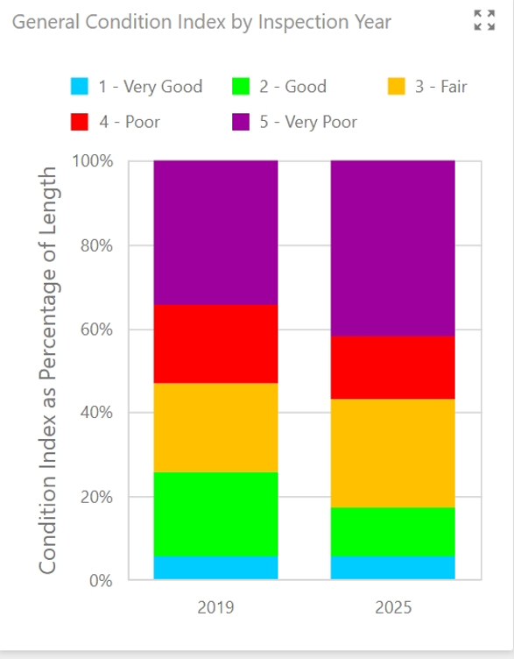
Service delivery challenges (Roads)
Maintenance of road network is extremely underbudgeted.
The RAMS indicate the total assets replacement cost of roads in the municipality is approximately R6.8 Billion.
The City had been struggling to even budget for up to 2.5%, of the asset replacement cost. Estimated at (170million).
The City has increased the budget for 2026/2027 from R25million to R50 Million with a view to increase it further in the outer years.
The budget is still far lower than the minimum of R 170 million required for maintenance.

Slide 86
5. Key Service Delivery Challenges
Water and sanitation services
The extent of any backlog in the provision of water and sanitation services has not been determined.
Without determining the need, the wider community of Mangaung remains without drinking water and proper sanitation for an extensive period.
Improper budget management led to underspending on water infrastructure, which contributed to the low-quality drinking water provided to communities.
Improper budget management led to underspending on sanitation infrastructure, exacerbating the existing sanitation shortcomings experienced.
There is non-adherence to Blue and Green Drop follow-up reports.
Water quality is not tested at the WTW.
Infrastructure | Quantity
WTW | 7
WWTW | 13
Sewer pumpstations | 19
Waterborne San | 205 154
VIP's | 50 477
Buckets | 1512
Unserviced | 27 093

Slide 87
Clarity:
As it would be noted that budget for maintenance and refurbishmnt is having constraints. The city undertakes condition assessments of WWTWs, prioritises as per criticality of the plants and the available budget, and then rollout refurbishsment program. The program does take longer than when the budget was sufficient.
The WWTW of Botshabelo, Thaba Nchu and Sterkwater were identified as more critical in 2024/2025 fiscal year. Thus, the refurbishment work prioritised these plants. On the current conditional assessment, Botshabelo and Thaba Nchu are partially functional, and the work will be continued until they are fully functional.
Wastewater Management
Water and sanitation services
Reasonable measures are not taken to prevent significant pollution and degradation of the adjacent environments, including water resources.
The municipal WWTW are not operational, and the raw / untreated effluent is discharged into the river streams, adjacent area, and other water sources.
The untreated or inadequate discharge affects the environment and health of users who are dependent on the contaminated sources.

Slide 88
Response
The City has reviewed the Road Asset Master Plan to inform planning for maintenance going forward. The draft plan was utilised inform the budget for 2026/2027 in order to adapt to proactive maintenance and avoid public liability claims.
The City is in a process of migrating from funding other services from Fuel levy and redirect this to fund the road and stormwater maintenance and upgrades through this grant. This will help the City to mitigate the challenges on road conditions that detailed in the City's Road Asset management plan which details the conditions of the municipal road infrastructure which are moving from poor to very poor.
Key Service Delivery Challenges
Road infrastructure
Road infrastructure maintenance is only carried out after a failure has occurred, while the intention is to restore an item to a state in which it can perform its required function before failure occurs.
Increased expenditure is incurred rather than performing planned, efficient preventative maintenance at a reasonable cost.
The continued deterioration of the municipal roads has led to the breakdown of the economic ecosystem within the Metropolitan area and increased pothole claims against the municipality.

Slide 89
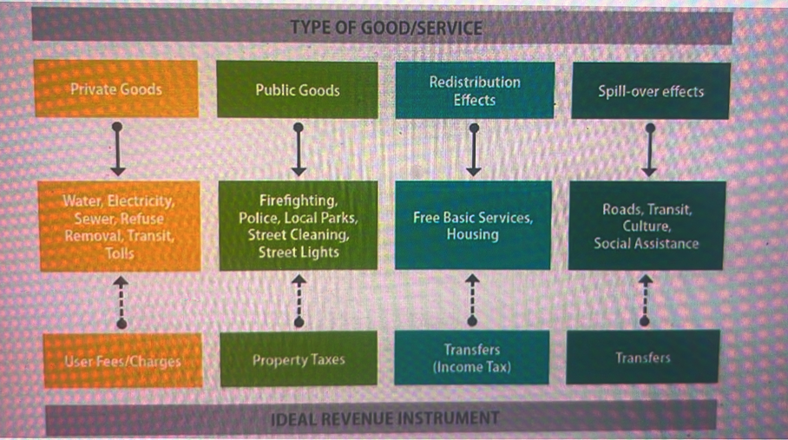
Key Service Delivery Challenges
The City evaluated source of revenue streams that can assist the municipality with roads infrastructure development and maintenance.
The major source identified was transfers through Fuel Levy that are received by all Metro Municipality and used to fund roads network.

Slide 90
Key Service Delivery Challenges
The re prioritisation by City to consider additional funding to through Fuel Levy emanate from the rapid deteriorating of the road infrastructure network.
The RAMS indicate the total assets replacement cost of roads in the municipality is approximately R6.8 Billion.
However , the City had been struggling to even budget for up to 2.5%, of the asset replacement cost. Estimated at (170million)
However, the City had increased the budget for 2026/2026 drastically from R25million to R50 Million with a view to increase it further in the outer years.

Slide 91
UIFW AND CONSEQUENCE MANAGEMENT
CITY MANAGER/CFO

Slide 92
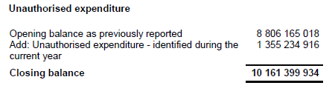
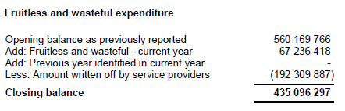
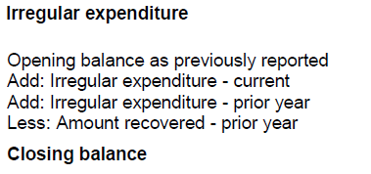

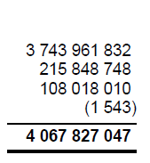
Unauthorised, irregular and fruitless and wasteful expenditure – By Type

Slide 93
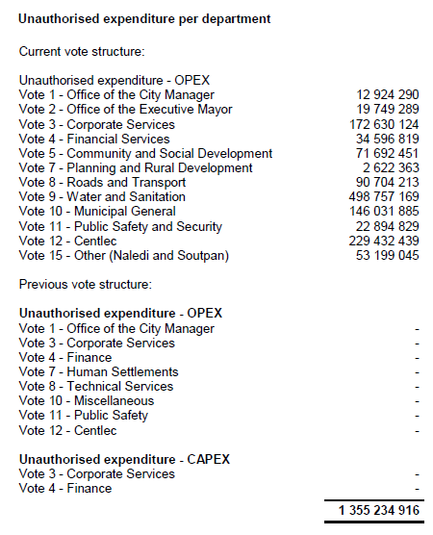

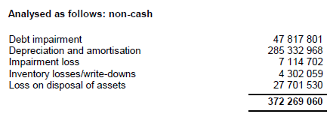
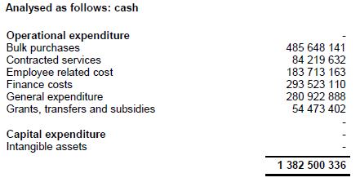
Unauthorised expenditure

Slide 94
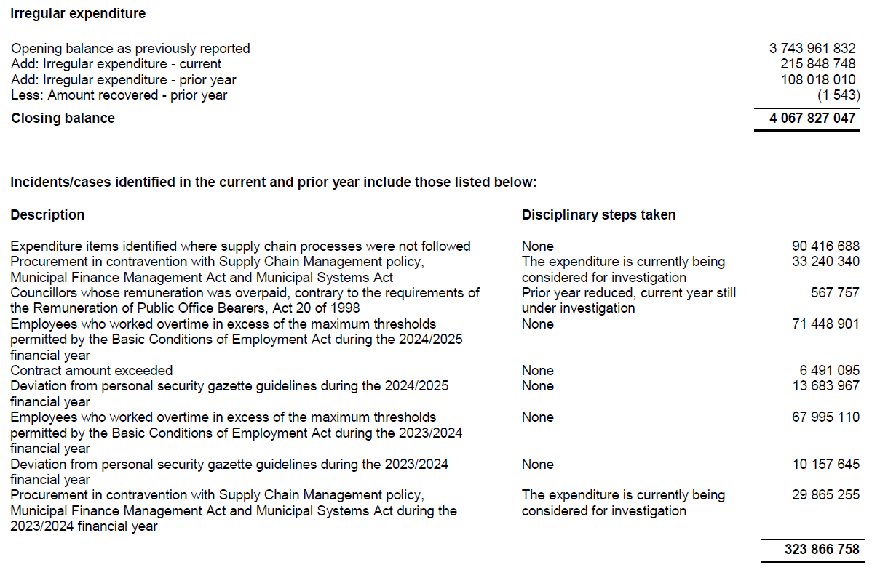
Irregular expenditure

Slide 95
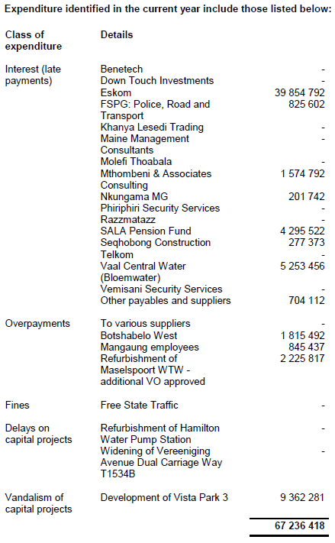
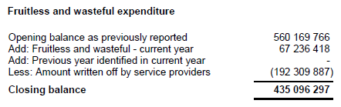
Fruitless and Wasteful expenditure

Slide 96
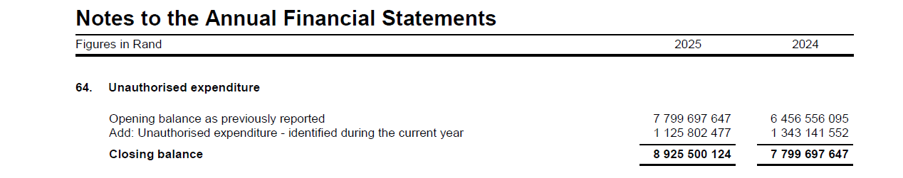
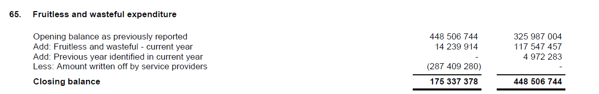
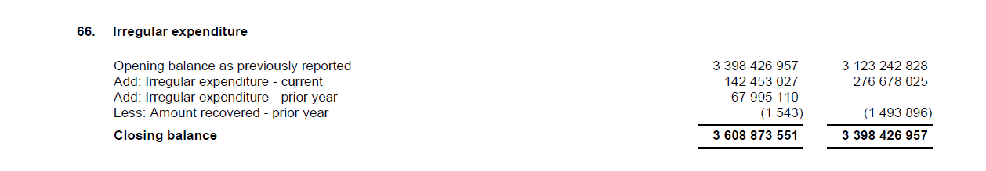
UIFW Status

Slide 97
Progress on UIFWe investigations - MPAC
To date, the Technical committee has completed 29 investigation on Fruitless expenditures as follows:
16 cases have been submitted to MPAC for discussion and resolution, to the value of R7 214 467.58.
13 cases have been concluded and enroute to MPAC, to the value of R192 740 933,16.
To date, the Technical committee has completed investigations on Unauthorized expenditures as follows:
Description | 2023/24 | 2024/25
Debt Impairment | 323 496 091 | 47 817 801
Depreciation and amortization | 282 524 139 | 66 951 606
Total | 606 020 230 | 114 769 407

Slide 98
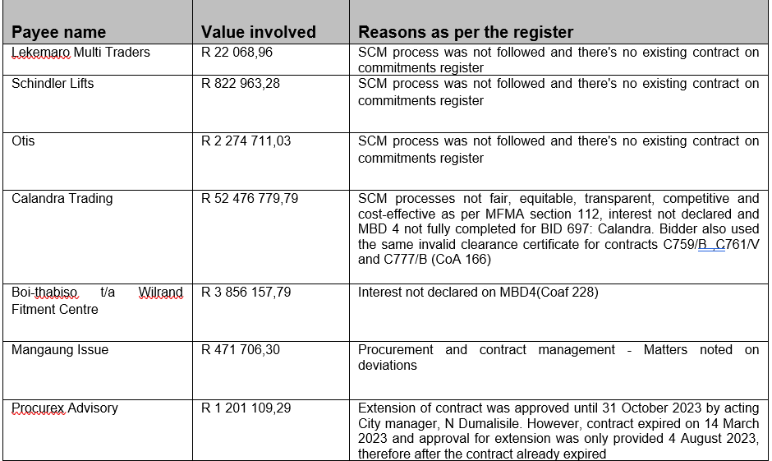
Matters referred to Financial Disciplinary Board

Slide 99
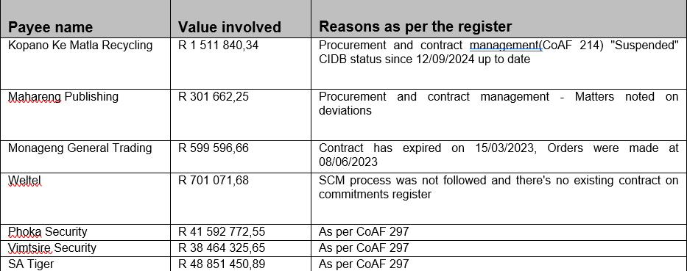
Matters referred to Financial Disciplinary Board /…2

Slide 100
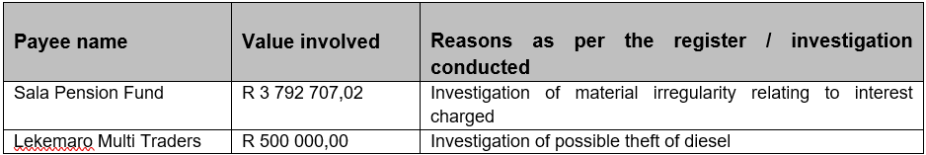
Matters referred to Financial Disciplinary Board
Payments identified as fruitless and wasteful expenditure referred to FDB:

Slide 101
Accountability and Consequence Management
MPAC Successes
  Investigated fruitless and wasteful expenditure to the tune of R434 million R434,768 million, of which R287million relates to interest on arrears in respect of Vaal Central Account – at the date of signing the agreement, the balance was approximately R606m
  The Vaal Central Board resolved to write off the accumulated interest in the total amount of R287 million – this was accrued and not paid – the write off became a reversal of the accrual
  Arrears to Vaal Central can be linked to low collection rate, liquidity issues that caused financial distress that ultimately led to the provincial and now Cabinet Intervention
  The difference in fruitless and wasteful expenditure reported is still being investigated – no recommendations had been made to Council as yet by MPAC
  Major cause is late payments that ended up in litigations (the city dealt with various litigations from legal services and contractors) no ringfencing of conditional grants prior to March 2023
  Currently dealing with unauthorized – non-cash items amounting to R7bn of the total reported
FDB referrals
  Referred by City Manager
    Fuel losses
    SALA Pension Fund – failure to adjust contributions in accordance with the pension fund rules as approved by FICA
  From the register
    3 Security tenders
    Weltel – telecommunications contract
    4 Expired contracts that continued beyond the period
    7 contracts where no SCM was followed
These matters are still under investigation
Still within the timelines as regulated – report back to the authority who made referred within 30 days
Same as reporting to council, it is within 30 days

Slide 102
Accountability and Consequence Management
To date, no charges had been laid on UIFW incurred, however, the process that has been adopted henceforth is the following
  Notification of HoD and laying of charges on a quarterly basis on UIFW identified (as per Section 52 (d) report
  Refer the notice and charge to FDB for investigation (City Manager referrals)
  Receive recommendations report and act as per recommendations
  At the same time, submit a report to MPAC on identified UIFW for investigation for recommendation to recover, write off or condone

Slide 103
LITIGATIONS
HOD DUMA/CITY MANAGER

Slide 104
Litigations

Slide 105
CENTLEC

Slide 106
1. FINANCIAL STATEMENTS
The majority of the current payables relate to bulk purchases owed to ESKOM while deferred tax liability is the majority of the non-current liabilities.
The property, plant and equipment remain the largest portion of assets. A R4,9 billion fair value revaluation was processed during the year.
Total assets exceed the total liabilities and therefore the positive net asset balance.

Slide 107
2. FINANCIAL PERFORMANCE
Total revenue amounted to R3,9 billion while total expenditure including noncash expenditures such as depreciation and impairments amounted to R4,5 billion.
Bulk purchases remain the largest expenditure item amounting to 62% of total expenditure.
Noncash expenditure amounted to 10% of total expenditure.

Slide 108
3. FINANCIAL RATIOS
Liquidity ratio:
The ratio indicates that we are below the norm of 2:1 for current and 1:1 for quick ratio. In essence, Centlec will be able to pay 30% of current liabilities from current assets
Solvency ratio:
The ratio evaluates long-term financial stability and capacity to pay off debts using earnings and internal cash flow. Currently the income will cover 0,02% of the total liabilities.
Total assets are 2,28 time the total liabilities indicating a positive asset to liability ratio

Slide 109

4. FINANCIAL SUSTAINABILITY
Management has no intention to liquidate the entity and is of the opinion that the municipal entity will continue to operate as a going concern for at least the next 12 months
Management is not aware of material uncertainties related to events or conditions that may cast significant doubt on the entity’s ability to continue as a going concern.
The greater majority of financial indicators as at year end 30 June 2025 indicate positive for the going concern assumption
The entity is still capable of operating as a going concern without the need for external funding and as at 30 June 2025 has not made use of any external financing source i.e. a bank loan to fund any operations

Slide 110

5. DEBT MANAGEMENT AND COLLECTION RATE
Majority of the debt book is for Free State Development Corporation (FDC) which owes R 465 million equivalent to 46% of the total debt of R 1 billion.
Provincial Government and Residentials, owe R268 million, equivalent to 26% of the total debt of R1 billion.
5,64% is the current account due on the 15th of June 2025.
During the year, revenue Billed Revenue was R 3 499 970 193 and a total of R 3 428 256 857 was collected, this equates a 97.95% collection rate for 2025

Slide 111

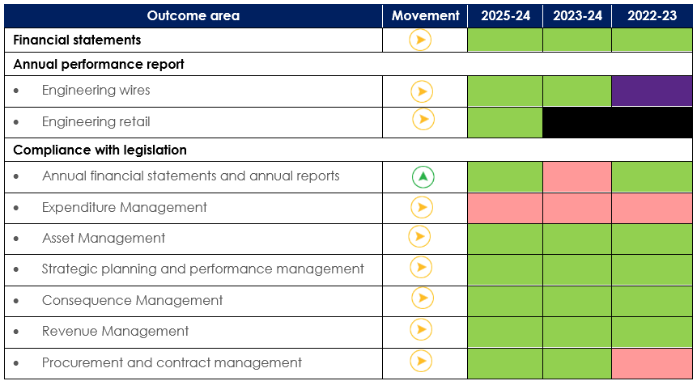
6. AUDIT OUTCOMES
The entity received an unqualified audit opinion with no material findings on the financial statements.
Centlec has improved the compliance with legislation on annual financial statements and annual reports.
Expenditure management has received material findings relating to compliance with legislation.

Slide 112
7. AUDIT ACTION PLAN 2024/2025
3
15
12/ 80%
15
80%
TOTAL FINDINGS RAISED
FINDINGS RESOLVED
AUDIT ACTION PLAN ITEMS
ACTION PLAN IMPLEMENTED
AUDIT OPINION HISTORY
AUDIT ACTION PLAN — PROGRESS & ROOT CAUSES
2024/25
Unqualified audit Opinion with Findings
Implementation
[80%]
2023/24
Unqualified audit Opinion with Findings
Common root causes: [inadequate controls / record-keeping]
Status split: [12] implemented · [3] in progress · [0] not started
Responsible officials :(CFO, HR & CIO)
Target date assigned per finding : 30 June 2026
Tracked by Internal Audit and reported to the Audit & Risk Committee
2022/23
[Unqualified audit Opinion with Findings
5
Notes:
Show the opinion trajectory, findings resolved, and action-plan implementation rate. Be candid about root causes and the tracking mechanism.

Slide 113
8. PERFORMANCE INFORMATION
2024 - 25 Annual Performance
Indicator description | Target | Actual Achievemnet
Number of new high mast lights installed within Mangaung Metropolitan area of supply | 40 | 40
Number of dwellings provided with connections to the mains electricity supply of the municipality | 1500 | 1521
Provision of 3% total residential electricity allocated as Free Basic Elecetricity by 30 June 2025 | 3% | 4,6%
Percentage of planned maintenance performed | 95% | 99,27%
Percentage of valid customer applications for new electricity connections processed in terms of mucipal services | 90% | 76%
Percentage of unplanned outages that are restored to supply within industry timeframes. (Aggregated - Single & Area Faults) | 98% | 90%

Slide 114
9. PERFORMANCE INFORMATION
Highlights & Challenges
Highlights:
The entity received a clean audit on Performance Information.
Challenges:
Infrastructure theft & vandalism resulting in prolonged unplanned power outages.

Slide 115
10. SERVICE DELIVERY
Progress made in addressing service delivery challenges
ITEM | SERVICE DELIVERY CHALLENGES | MITIGATION
1. | Prolonged Power Failures | Scheduling more planned maintenance activities Replacement of aged infrastructure. Capacitating the 24-Hour standby office to ensure availability of adequate personnel
2. | Limited Grant Funding | Application for UDFG funding for identified infrastructure projects. Request to MMM on the USDG and ISUPG needs to finance CENTLEC bulk infrastructure projects
3. | Small Scale Embedded Generation (SSEG). | Draft RFP for the proposed 30 MW Solar Plant and appointment of service provider Build internal capacity around the renewables to ensure the continuous development.
4. | Strengthening of Infrastructure Security against Theft and Vandalism | Application of Surveillance Systems and Assets Tracking devices Installations of protective steel frames around mini-substation and pillar boxes around identified hotspots areas.

Slide 116
SERVICE DELIVERY…cont
FOUR INITIATIVES, ON SERVICE DELIVERY
A connected transformation programme on Services delivery initiatives
01
02
03
04
CENTLEC Digital App
Online Recruitment System
Enhanced Call Centre
Data Centre
Self-service, real-time information and digital fault reporting for customers.
A fully digital, transparent and paperless recruitment process.
Faster response times with better call tracking and service monitoring.
A modernised, secure and scalable Data Centre platform.
THE GOAL
Together these initiatives improve ICT-enabled service delivery, raise customer satisfaction, strengthen operational efficiency and support long-term financial sustainability.

Slide 117
11. STRATEGIC RISKS
No | Risk | Residual Risk | Mitigating Action Plans | Timelines
1 | Failure to adapt to changing market/ customer needs and Preferences | High | Advertised RFP for renewable energy sources, battery energy storage, micro plates. Advertised RFP for a panel of consultants (technical and financial advisors) Appointment of service provider through RFP for the 30 MW Solar Plant. Strategic plans to be presented to the National Treasury for funding (received first trench trading funding). | Q1 2026/27 Q1 2026/27 Q1 2026/27 Ongoing
2 | Theft and vandalism of the Electrical Infrastructure | High | Patrolling by the Security Personnel. Installation of cameras and alarm systems Engagements with communications on reaching a larger mass of people, such as through social media to inform and instil fear. Installation of early detection warning systems. | Continuous Q1 2026/27 Continuous Q2 2026/27
3 | Going concern | High | Approval of Revenue enhancement strategy Approval of Integrated Energy Plan Improve collections Monitor going concern | Q1 2026/27 Completed Continuous Monthly
4 | Decline in Revenue (Sales quantity) | High | Development of revenue enhancement strategies Reduction of tariffs through renewable energy / alternative energy. Tarriff restructuring | Q1 2026/27 Q4 2026/27 Completed

Slide 118
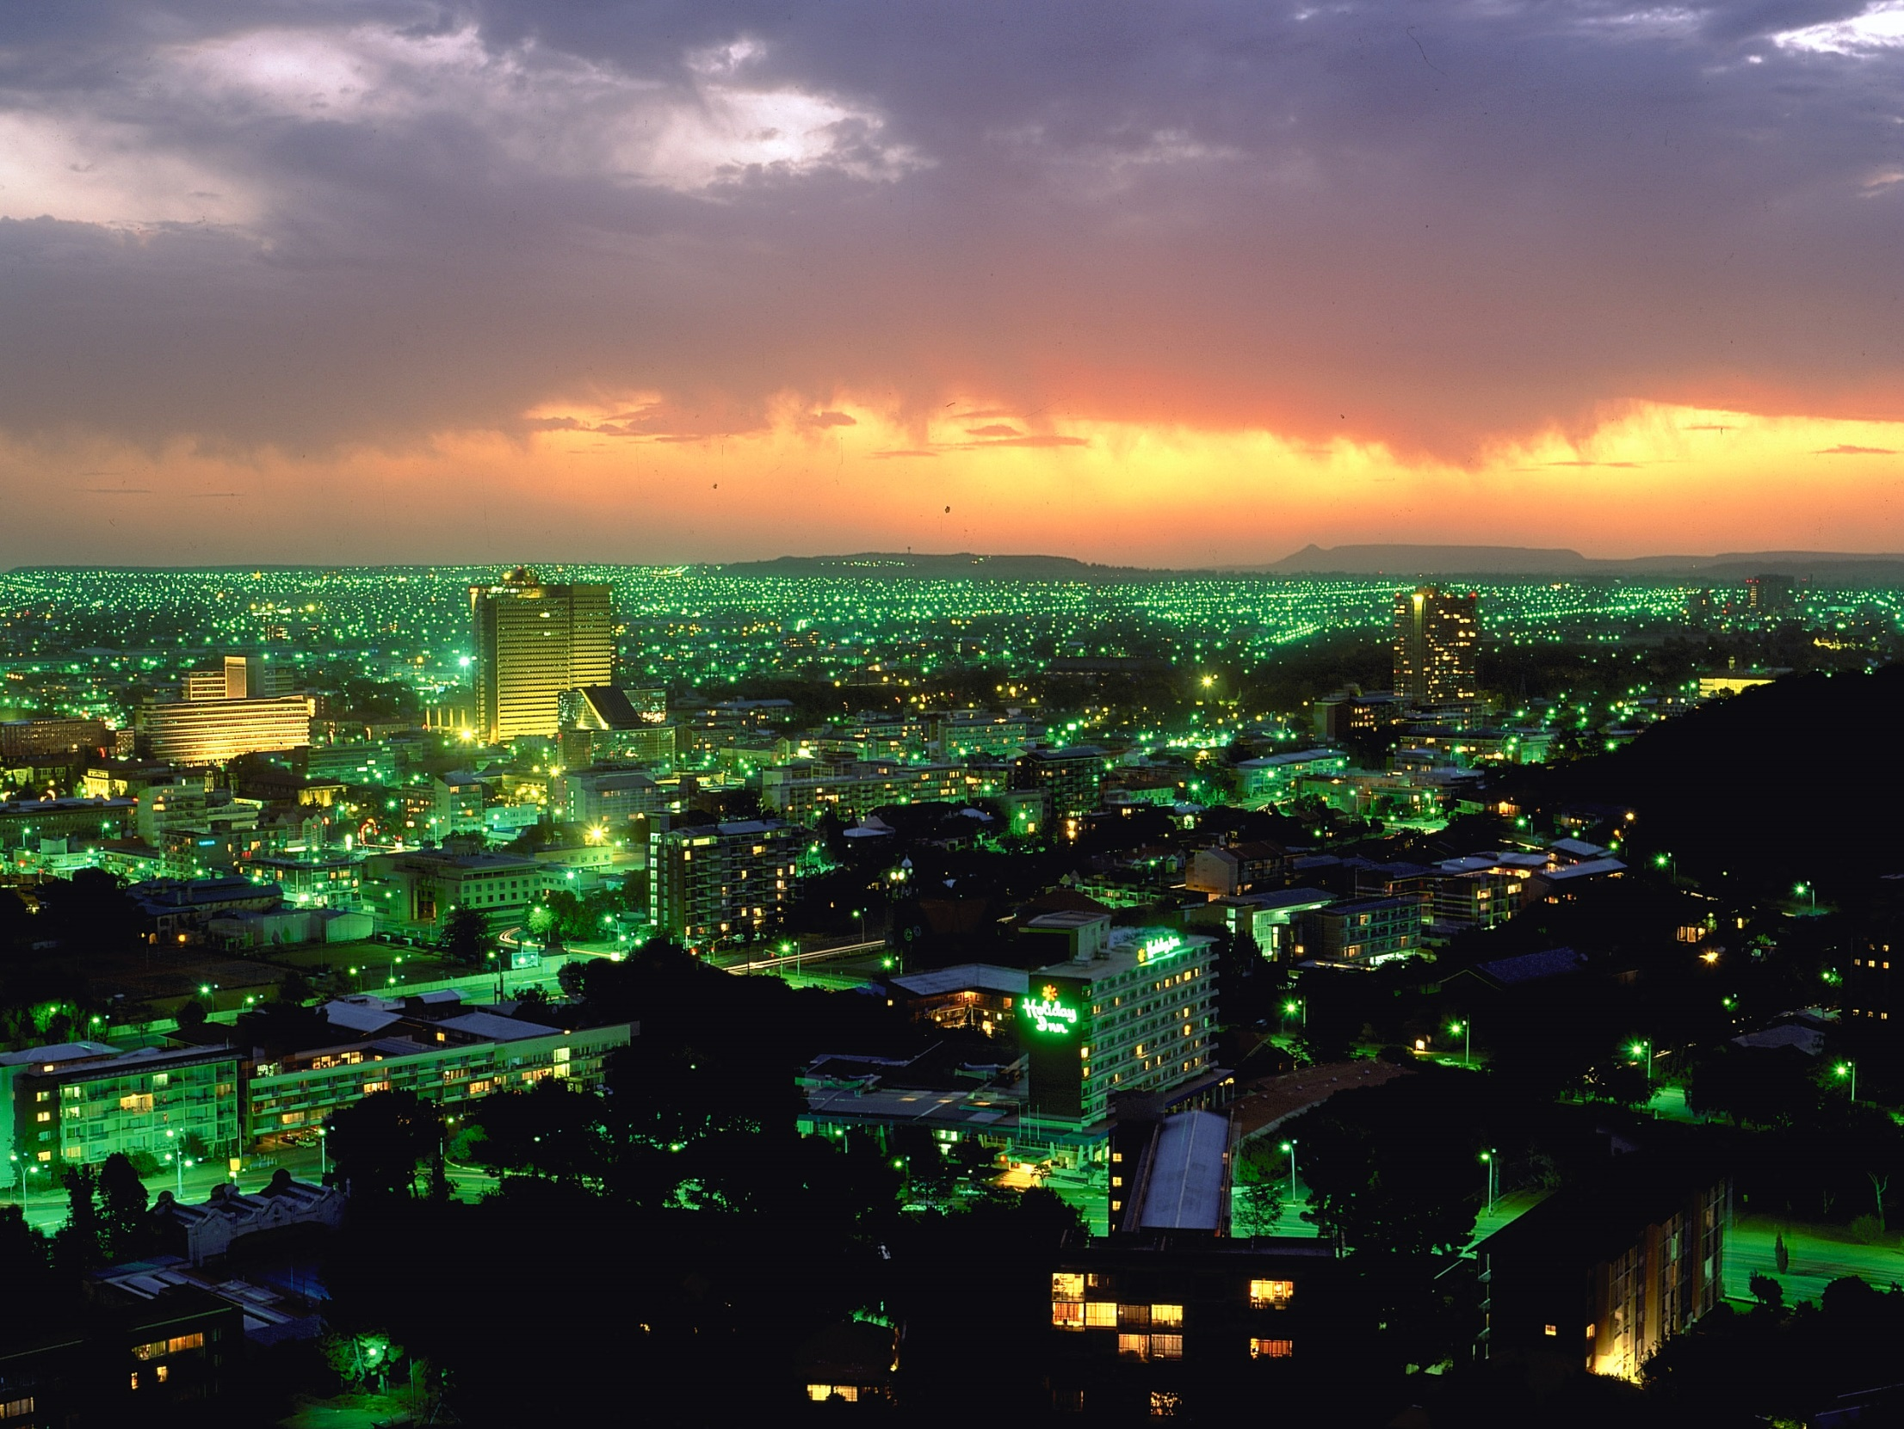
THANK YOU

